Slide 1
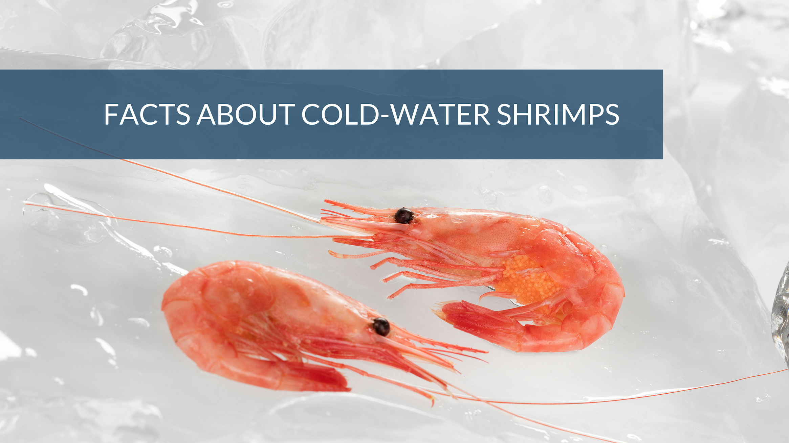
IDEA CRUSHERS
AUTOMATION FOR FEEDERS

Slide 2



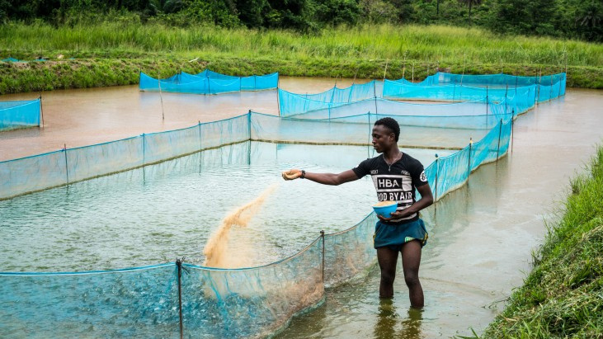

Can we revolutionize the aquaculture industry and enhance feeding practices for optimal growth and sustainability?

Slide 3
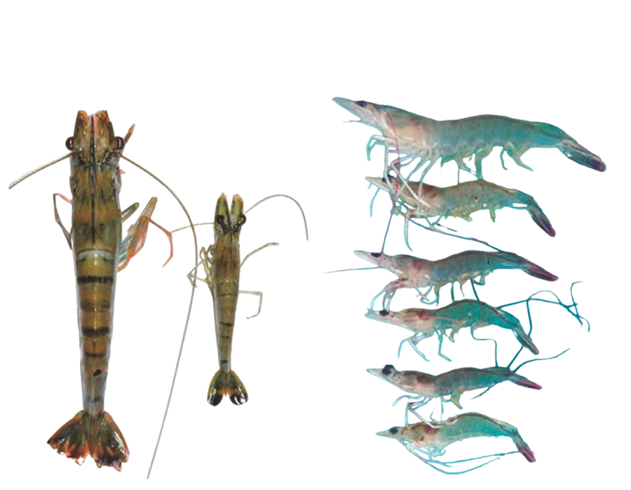
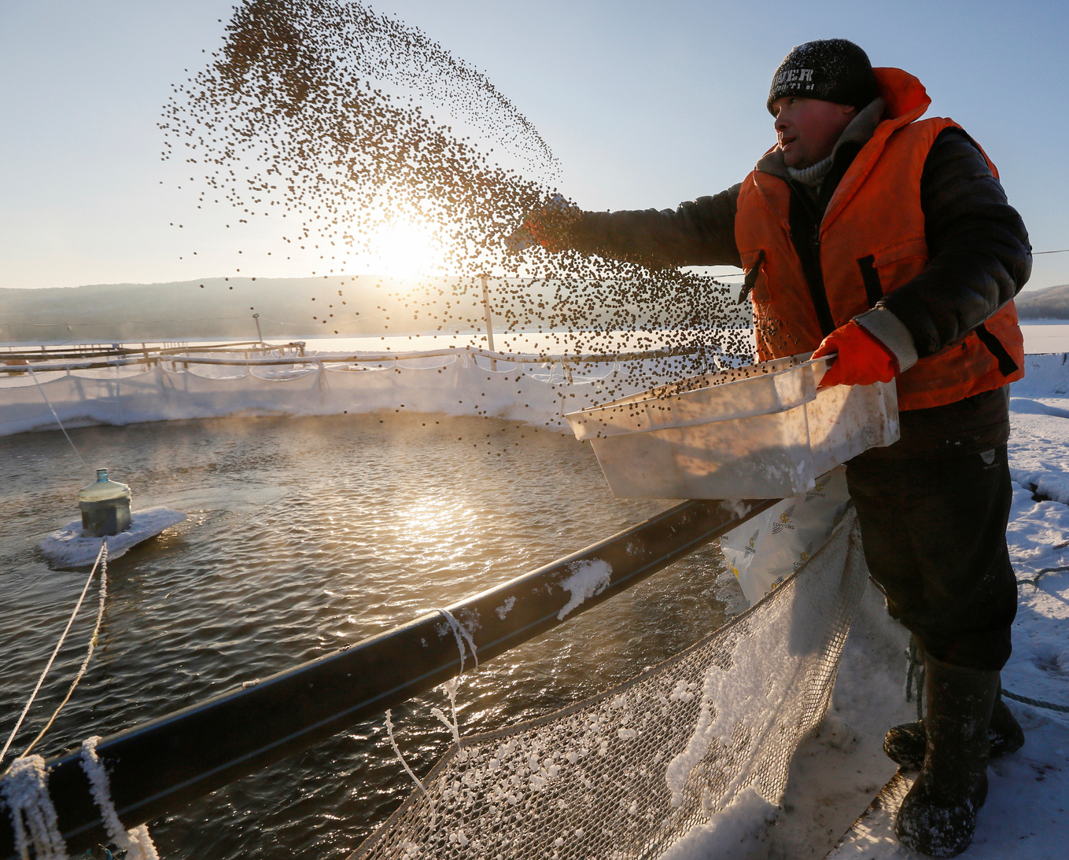

THE PROBLEM
Manual fish feeding​
Irregular Growth
Low Yield

Slide 4
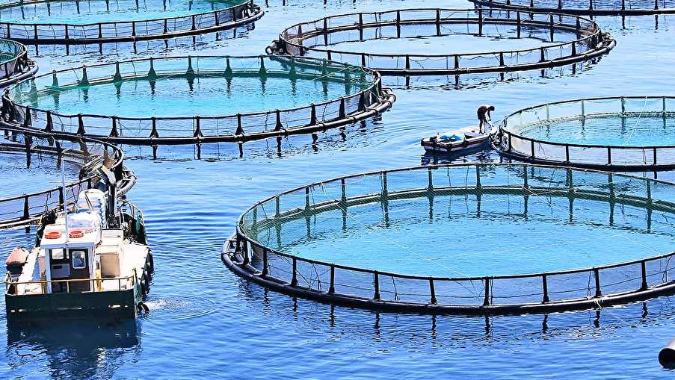

Why Now?
Increasing demand
Technological advancements
Environmental considerations.
Competitive advantage
Cost Efficient.
Supportive ecosystem

Slide 5
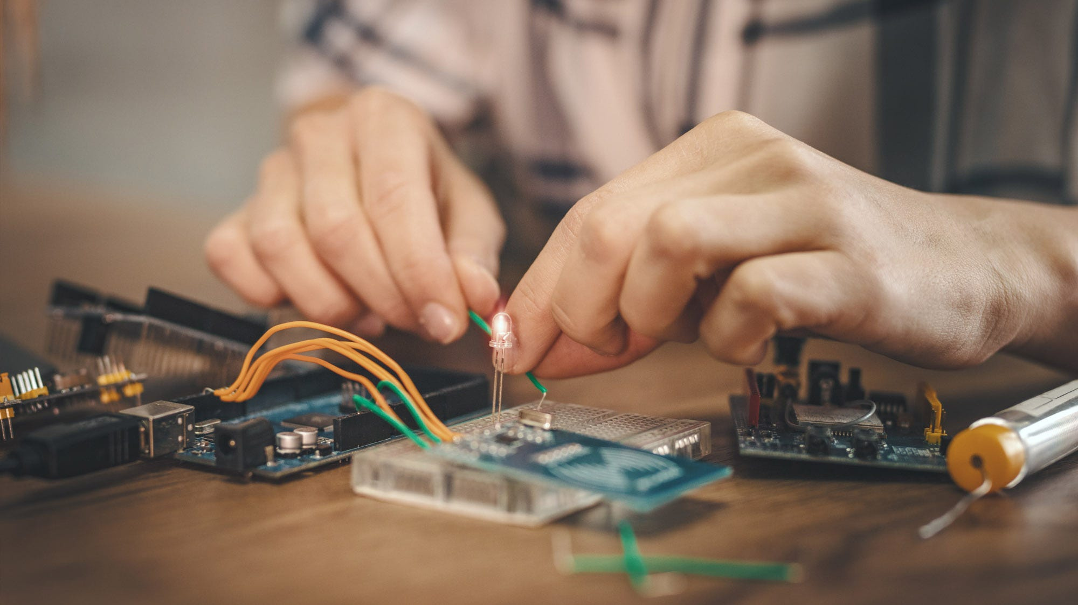
Hardware Components:
Raspberry Pi 4 Model B
Sensors
DC Motor
IoT Module
Technology Stack:
Python(Machine learning)
Android Application(Java, XML, Firebase)
Firebase(Cloud)

Slide 6
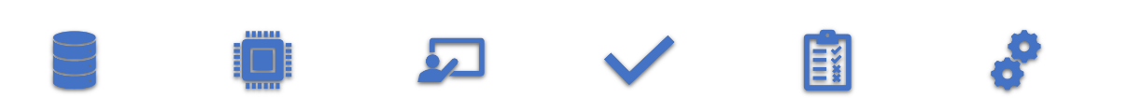

WORK FLOW
Data Collection
Data Pre-Processing
Model Training
Evaluating
Integrating
Deploying

Slide 7
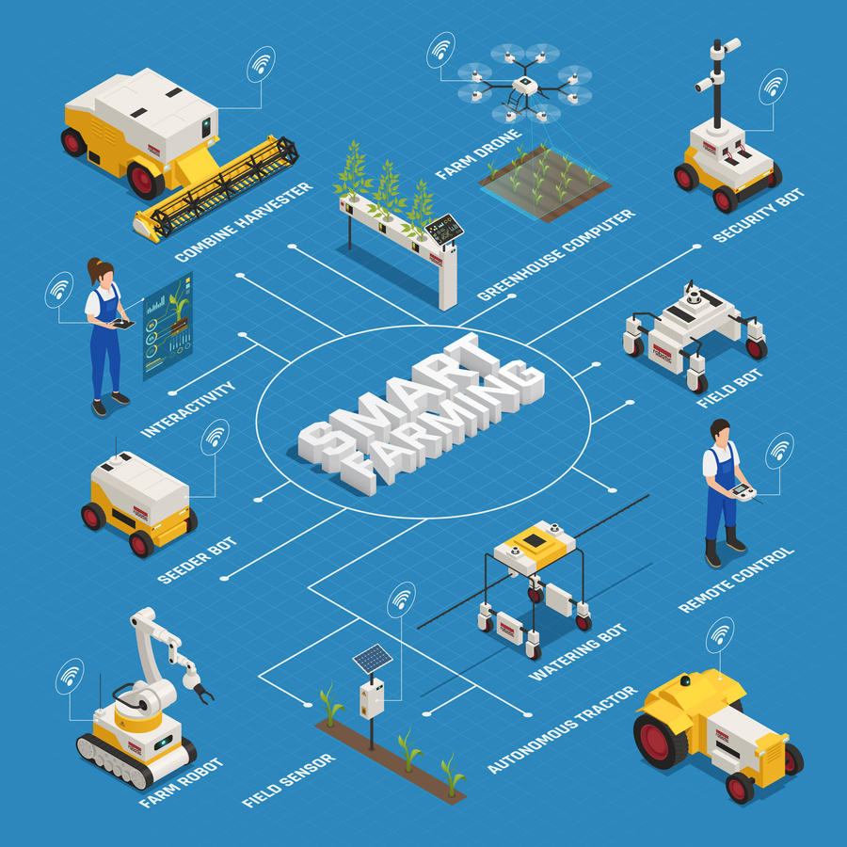
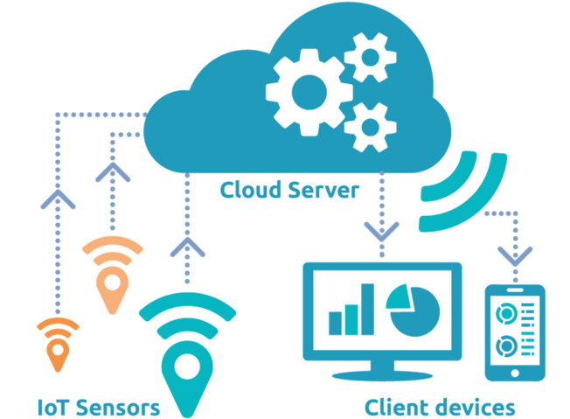
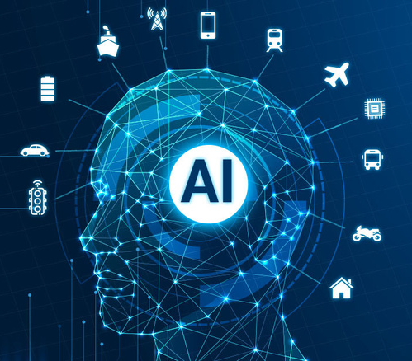
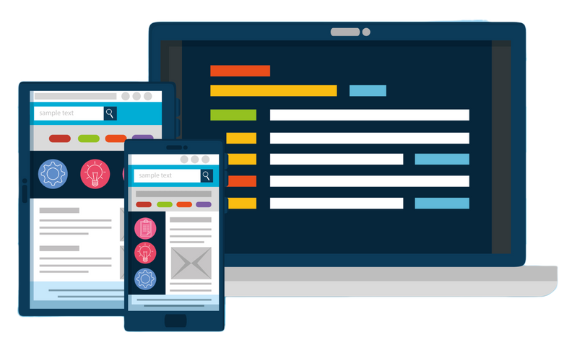
SOLUTION
AI
technology
IoT & Cloud connectivity
User-friendly interface
Integration of sensors

Slide 8








ADVANTAGES
Minimize Feed Waste
Easy Maintainance
Semi Automated
Regular Growth
Cost Efficient
Smart Alerting

Slide 9
SYSTEM ARCHITECTURE
Model
Model
Temperature Sensor
Temperature Sensor
Pond Data
Pond Data
Raspberry pi
Ph Sensor
Raspberry pi
Ph Sensor
Quantity Released
Quantity Released
Quantity Left
Do Sensor
Quantity Left
Do Sensor
Food Dispenser
Food Dispenser

Slide 10
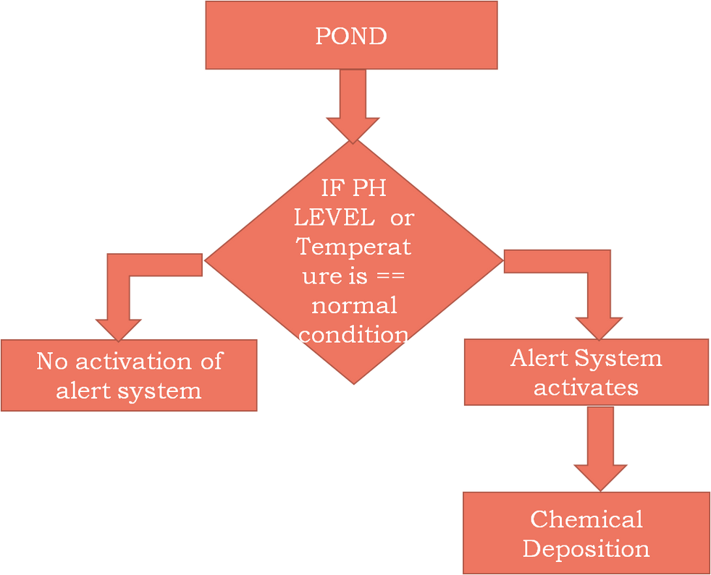
Smart Alert System
Various chemicals can be employed to manage water temperature in aquaculture ponds, depending on the specific requirements of the aquatic organisms. Here are a few examples:
Calcium oxide (CaO): Increases water temperature by raising pH and promoting heat-generating microorganisms.
Sodium carbonate (Na2CO3): Raises pH and encourages heat-producing microorganisms to elevate water temperature.
Ammonium sulfate ((NH4)2SO4): Lowers water temperature by absorbing heat from the environment, commonly used in warm-water aquaculture systems.

Slide 11
TIMELINE
RESEARCH AND DEVELOPMENT (3-6 MONTHS)
PILOT TESTING AND OPTIMIZATION (3-6 MONTHS)
MARKETING AND LAUNCH (1-2 MONTHS)
PROTOTYPE DEVELOPMENT (1-2 MONTHS)
MANUFACTURING AND PRODUCTION (2-3 MONTHS)
SCALING AND EXPANSION (ONGOING)

Slide 12







GO TO MARKET STRATEGY
Unique Value Proposition, Benefits, and Sustainability
20%
25%
Providing scalable implementation, training, and ongoing support for customers.
15%
Focusing on Targeted Customer Segments
30%
Strategic Partnerships with Feed Manufacturers,
Equipment Suppliers, and Distributors
20%
Targeted Marketing, Industry Events, and Influencer Collaboration

Slide 13
Control & Monitor the farm from your home
Equally distributed Food
Maintaining all values of pH and Temperature
Increased Yield & Efficiency
Automating Feeding
Nutritional deaths is reduced
Using Datasets of seasonal conditions and pond population which helps to reduce the raw materials
SUMMARY

Slide 14
REQUIREMENTS FROM IIT
Funding Support: We seek financial backing to support the development, production, and scaling of our AI-enabled automatic feed dispenser system. This will enable us to bring our innovative solution to market and drive growth.
Mentorship and Technical Expertise: Guidance and mentorship from experienced professionals in the aquaculture industry and technology sector would greatly benefit our startup. Their expertise and insights will help us navigate challenges, refine our strategy, and make informed decisions.
Research and Development (R&D) Support: Collaboration with research institutions, such as IITM, for R&D activities would enable us to further enhance the performance and capabilities of our system. Access to specialized knowledge, facilities, and resources would accelerate innovation.
Lab Testing and Manufacturing Support: Utilizing the lab facilities and equipment available at IITM for product testing and manufacturing would expedite the development process. Access to a dedicated space for prototyping, testing, and production would be highly beneficial.

Slide 15

THANK YOU

